Slide 1
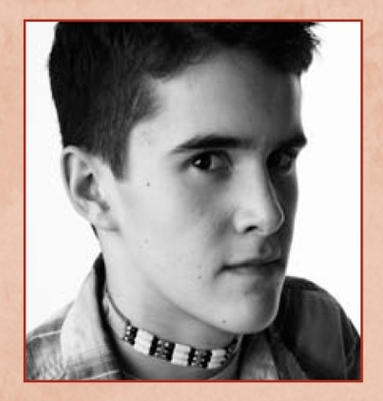
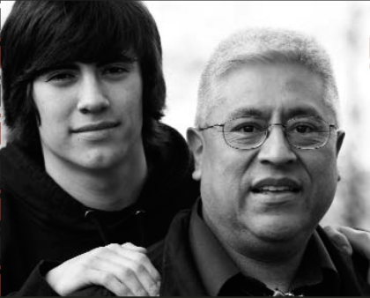
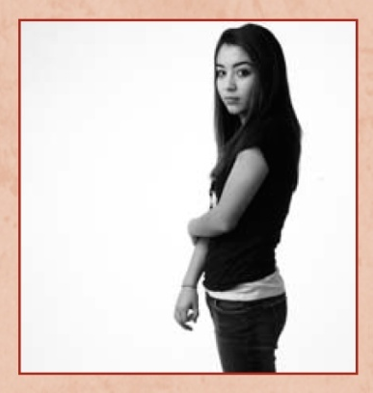
Current Projects
We R Native
It’s Your Game
Native VOICES
Native STAND
LGBT Materials
HIV/STD Screening Initiative
THRIVE: I Strengthen My Nation

Slide 2
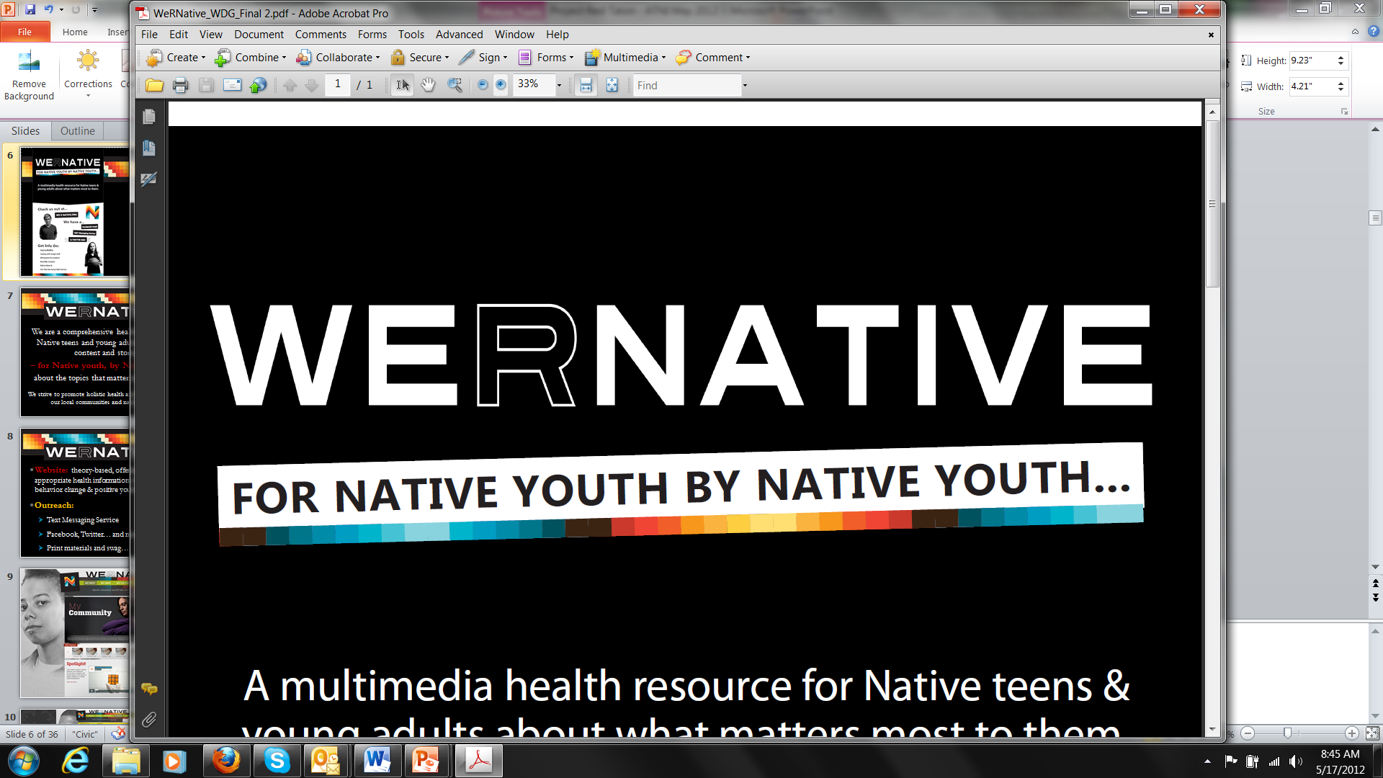
A multi-media health resource for
Native teens & young adults with content
about the topics that matter most to them.
Notes:
We R Native

Slide 3
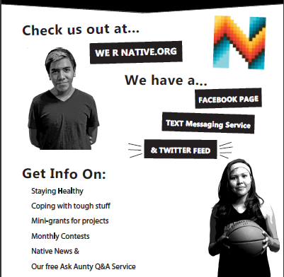
Notes:
We Have a Website: www.weRnative.org
(Theory-based, offering culturally-appropriate health information - with tools for behavior change & positive youth development.)
Text Messaging Service: Text NATIVE to 24587
… and a Facebook page, YouTube channel, and Twitter feed.

Slide 4
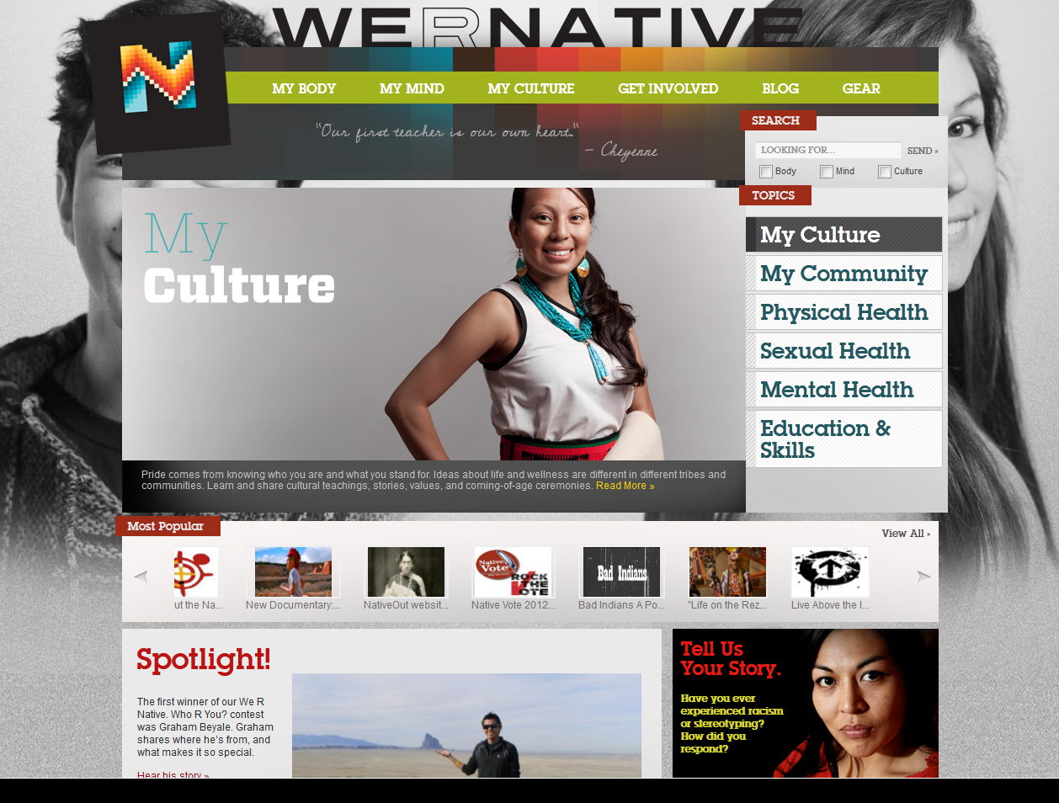
Notes:
The website is funded by the President’s National HIV/AIDS Strategy and the Indian Health Service’s National HIV/AIDS Program, and run by the Northwest Portland Area Indian Health Board.
The site focuses on health and social issues important to Native youth.
Native youth, elders, and topical experts from throughout the U.S. have contributed to the site… as authors of blogs, directors of videos, graphic design artists, and more.

Slide 5
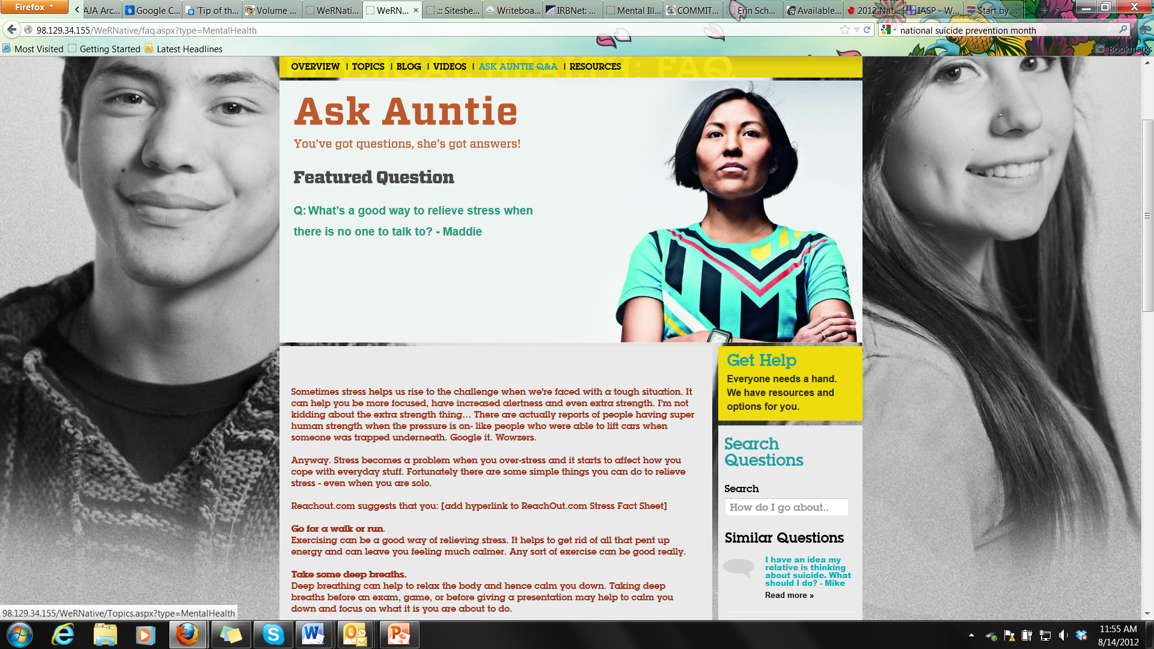
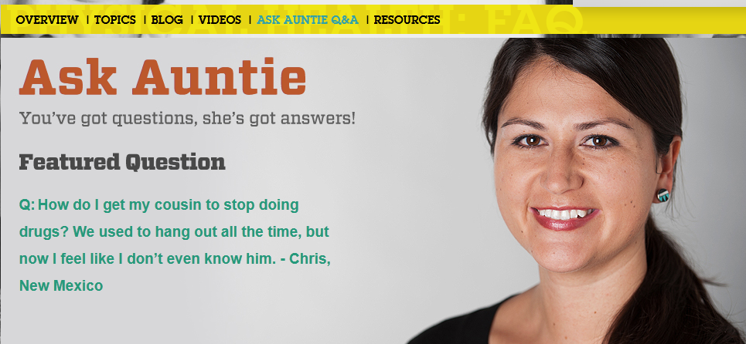
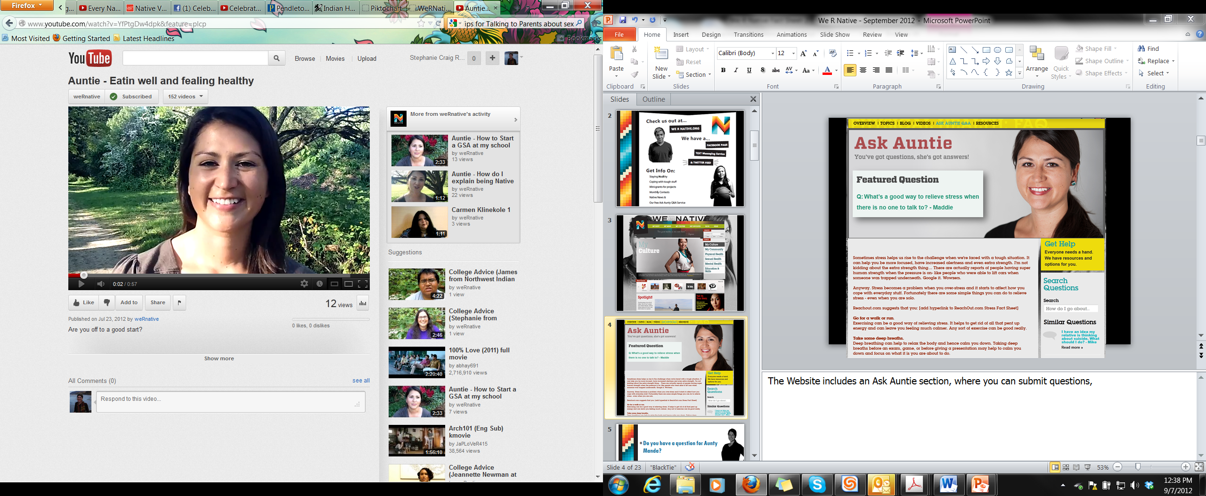
Notes:
The website includes an “Ask Auntie” section, where you can submit your own questions, search other people’s questions, and view Auntie’s responses.

Slide 6
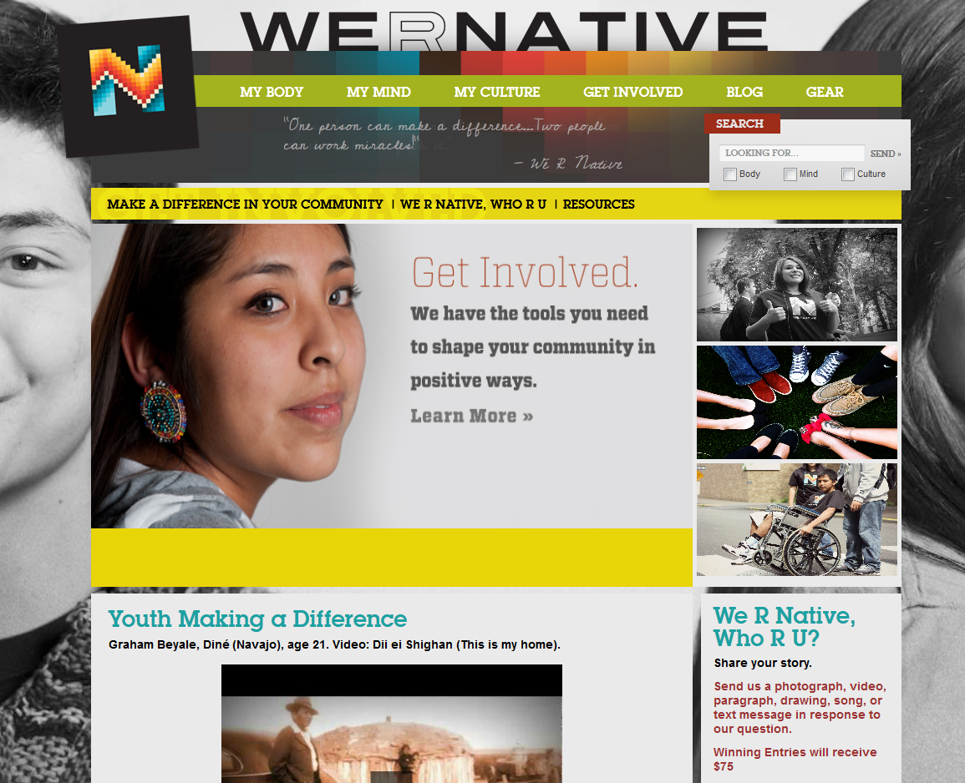
Notes:
The “Get Involved” section of the website focuses on:
Community Service Projects (and mini grants up to $475)
A Monthly “We R Native, Who R You?” Contest ($75, $50, and $25 prizes)
And showcases Native teens and young adults doing great things in their communities.

Slide 7
We R Native, Who R You?
Monthly Contests
  Send a photograph, video, paragraph, drawing, song, or text message in response to the question.
  Winners : $75 – 1st, $50 – 2nd, and $25 – 3rd
Notes:
Every month the site also features a new contest.

Slide 8
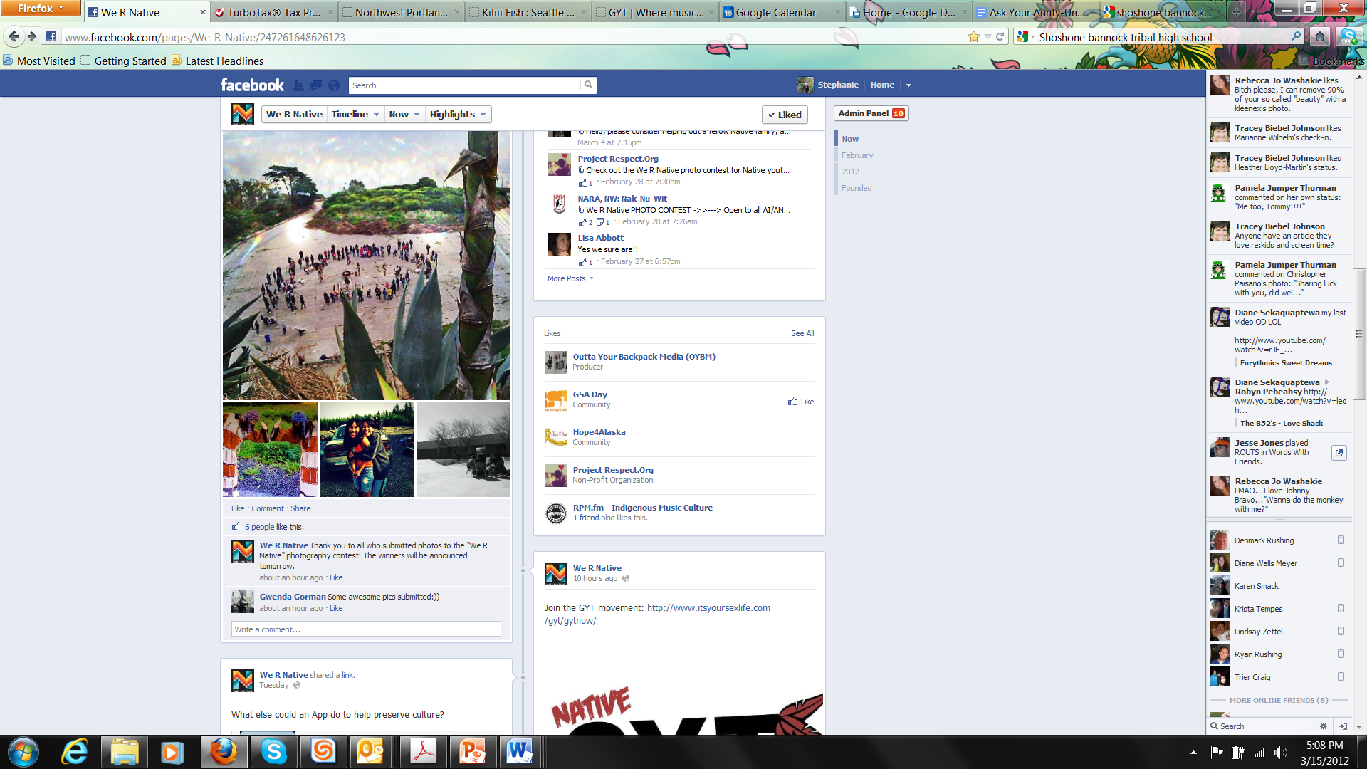
Notes:
This is We R Native’s facebook page….
These are photos from a recent We R Native, Who R You? photography contest.

Slide 9
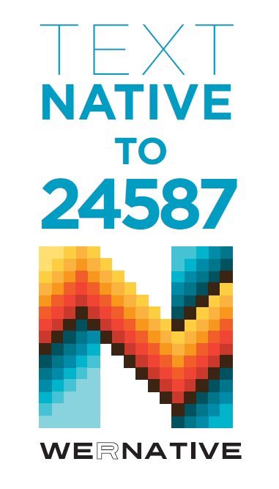

Notes:
To join the Text Messaging Service, text the word NATIVE to 24587
Over 900 people have signed up for the service.

Slide 10
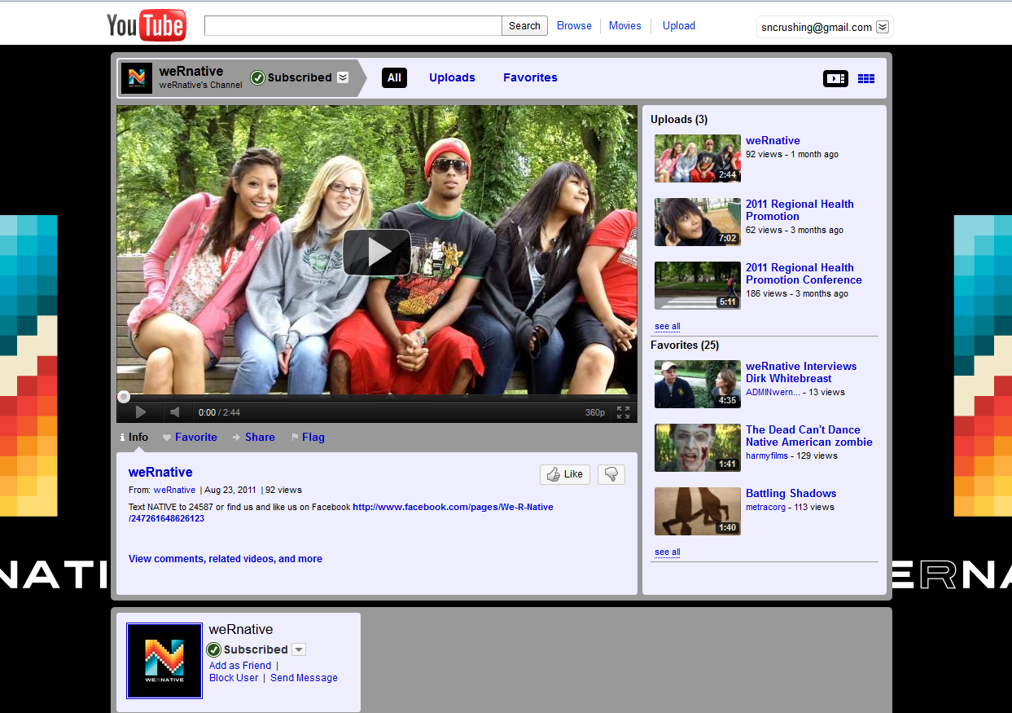
Notes:
Watch videos on our YouTube channel.

Slide 11
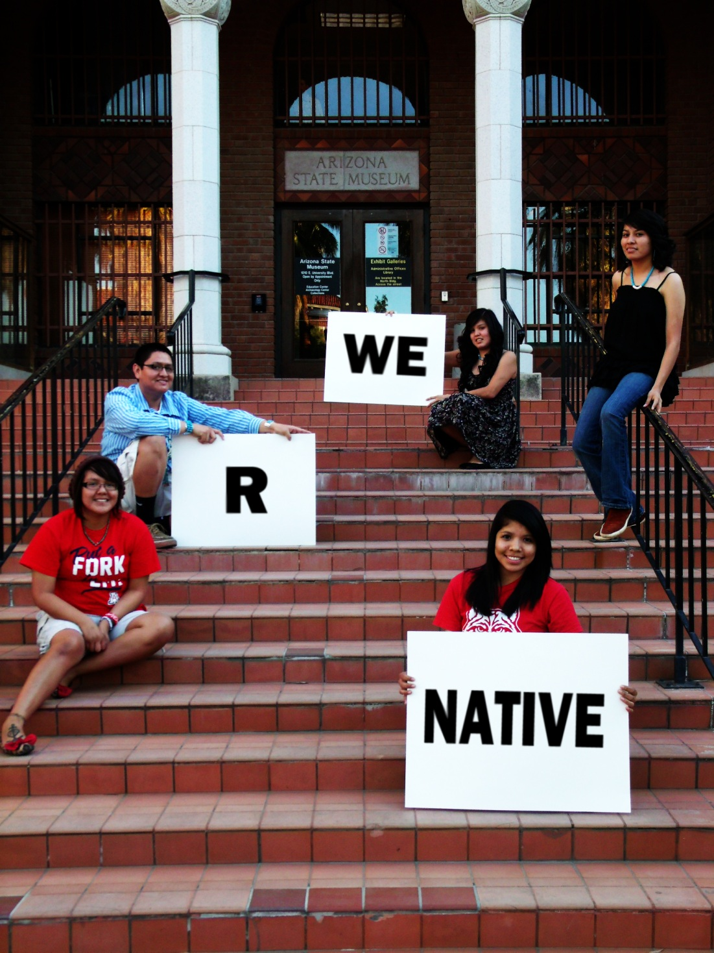
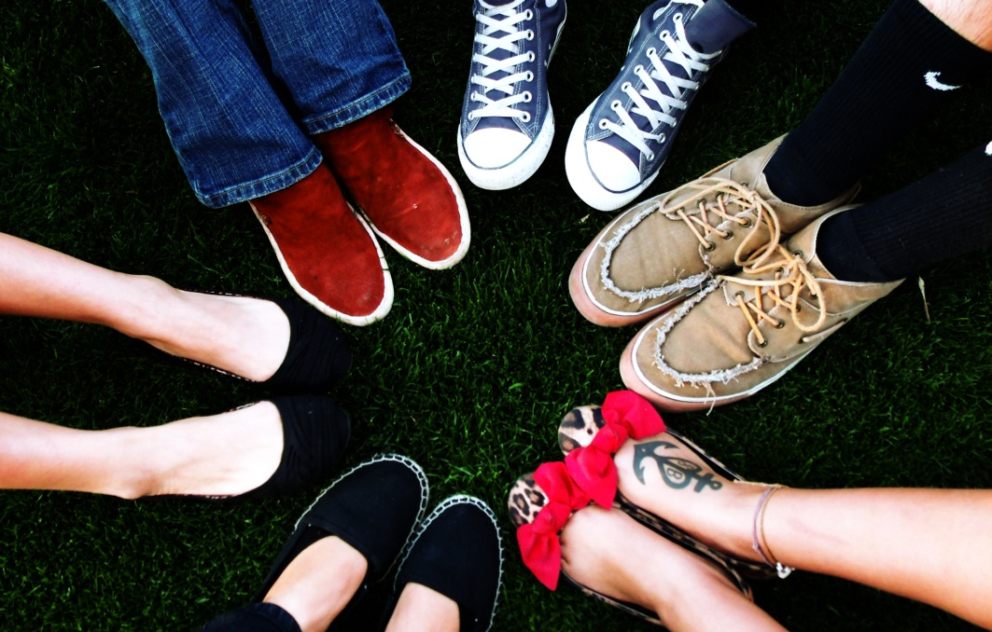
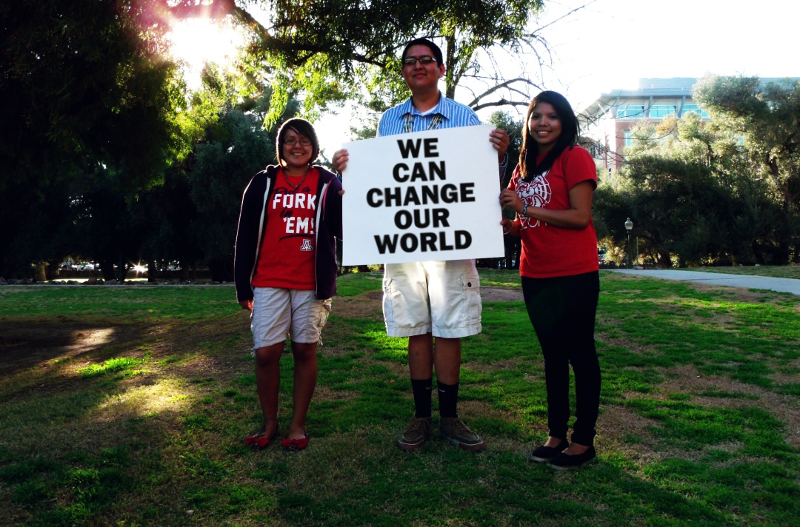
Notes:
Small amount but can accomplish great things! Also feel like it’s important to reflect the positive things youth are doing back to young people.
We believe at We R Native that Native youth can change our world…

Slide 12
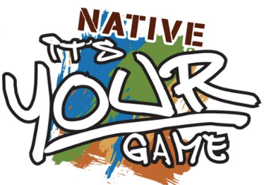
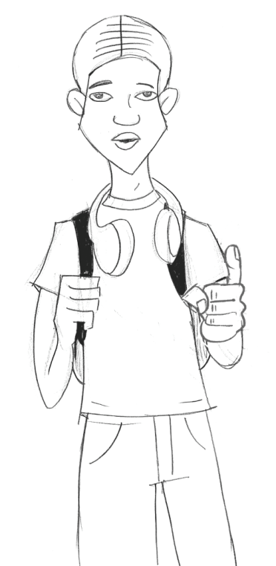
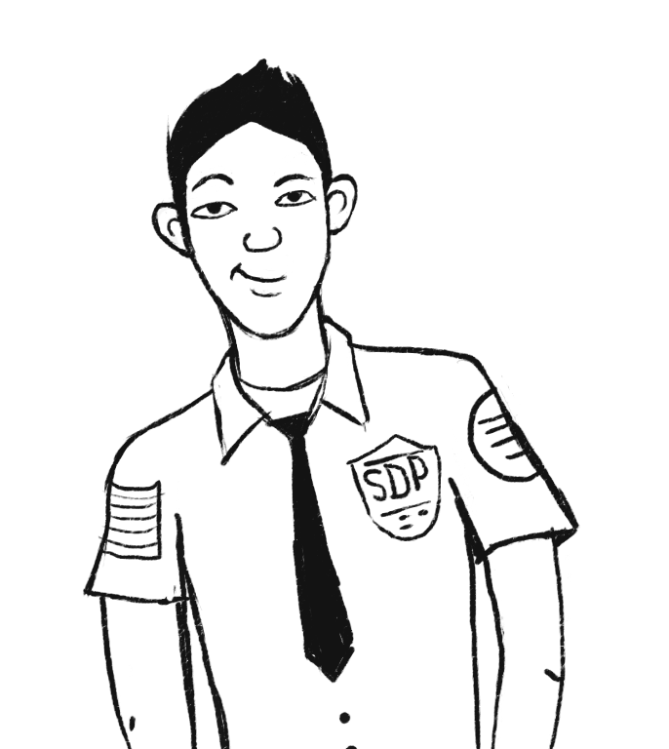
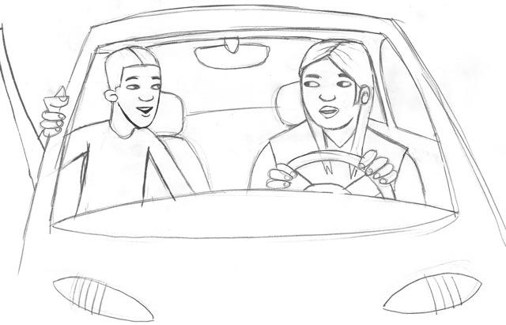

Slide 13
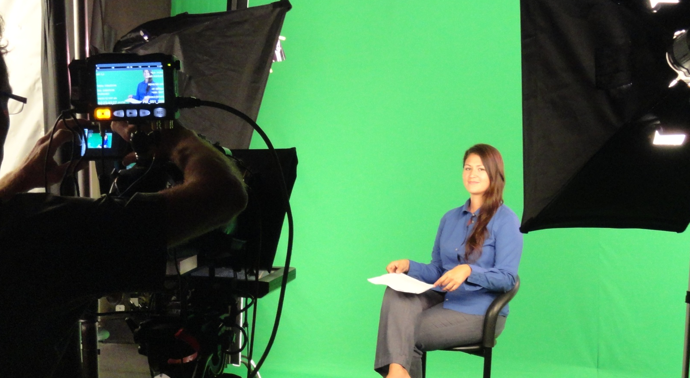
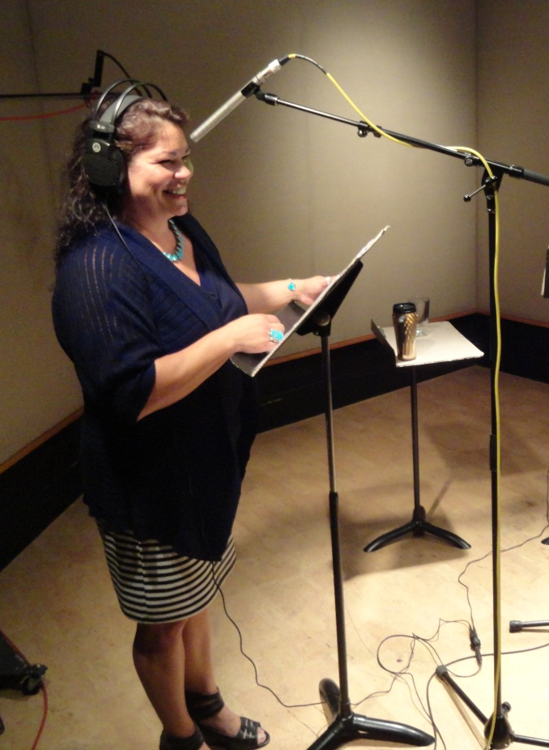
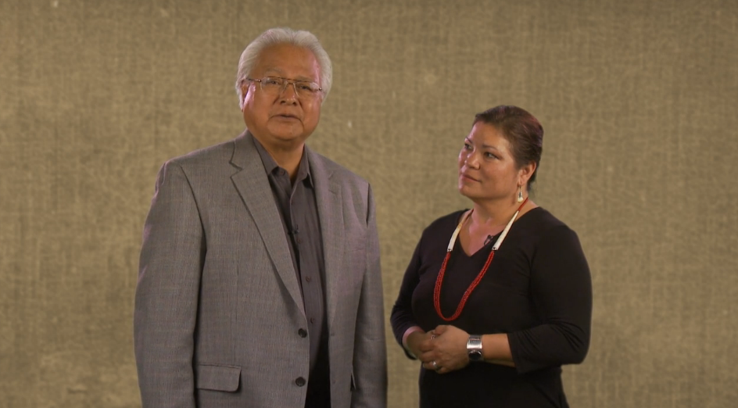

Slide 14
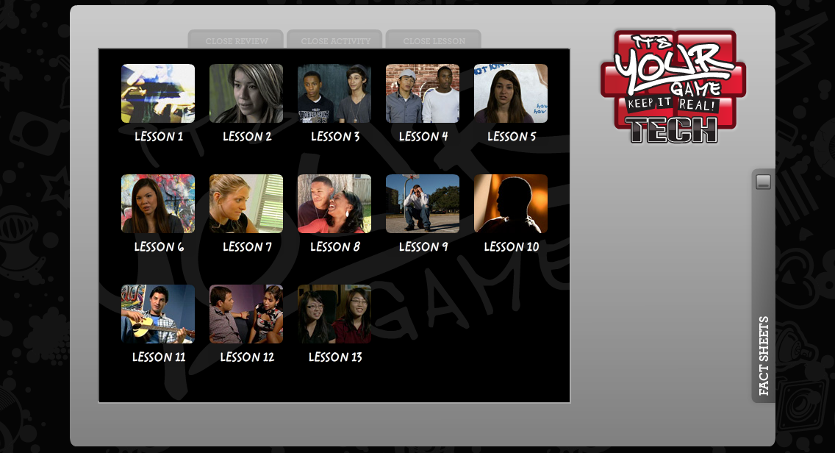
It’s Your Game

Slide 15
IYG Tech: Lessons & Topics
1 | Introduce IYG program; determine personal strengths
2 | Characteristics of healthy and unhealthy friendships
3 | Introduce “Select, Detect, Protect”: Identify personal rules & risky situations
4 | Characteristics of clearly saying “no” . Effective/ineffective refusal skills
5 | Anatomy, physiology, and reproduction
6 | Characteristics of health/unhealthy dating relationships; respecting others’ rules
7 | Social, emotional, physical consequences of sex; reasons to wait
8 | Communication & negotiation skills practice; Internet communication & safety
9 | Consequences of teen pregnancy
10 | Consequences of STI/HIV & the importance of testing
11 | Condom and contraception knowledge and skills
12 | “Select, Detect, Protect” review; condom negotiations
13 | Review of IYG; personalize reasons for not having sex
Notes:
IYG Tech is a 13-lesson, completely on-line version of IYG currently being evaluated in a randomized controlled trial in Houston, TX, funded by National Institute for Mental Health (NIMH) (Shegog & Peskin, Joint PIs).
It will form the basis for the IYG version that will be adapted for AI/AN youth in the current study.

Slide 16
It’s Your Game Sites
Warm Springs (MoA Signed)
Coquille Indian Tribe Community Health Center (MoA Signed)
Shoalwater Bay Education Department (MoA Signed)
Tulalip Boys and Girls Club (MoA Signed)
Wadatika Health Center - Burns Paiute Tribe (MoA Signed)
Yakama Nation Tribal School (MoA Signed)
Lapwai Boys and Girls Club - Nimiipuu Health Center (Lapwai MS/HS)
Lummi Tribal School
Paschal Sherman Indian School
Sunridge Middle School (Pendleton)

Slide 17
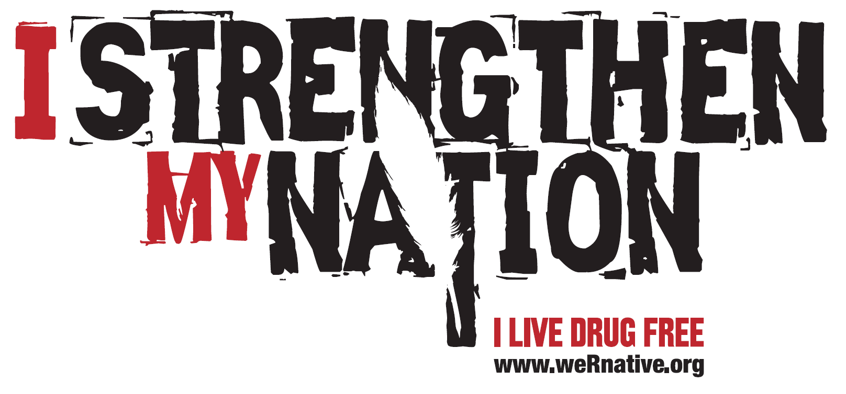
Notes:
The I Strengthen My Nation campaign was developed in partnerships by the Northwest Portland Area Indian Health Board and KAT Communications, with input from hundreds of teens, parents, and health educators from throughout the U.S.

Slide 18
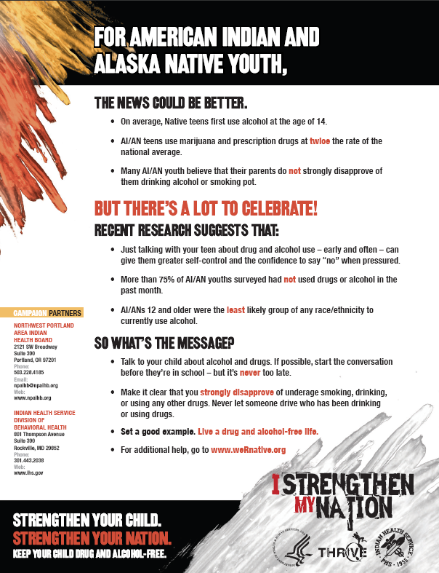
The campaign includes:
Logo jpegs
3 Posters
2 Brochures
1 Fact Sheet
Window Cling
Lanyard
T-shirts
A 30 second Radio PSA
A 30 second Video PSA
A 3 minute Video PSA (that will run on GoodHealth TV in IHS waiting rooms)
Notes:
Image: Fact Sheet

Slide 19
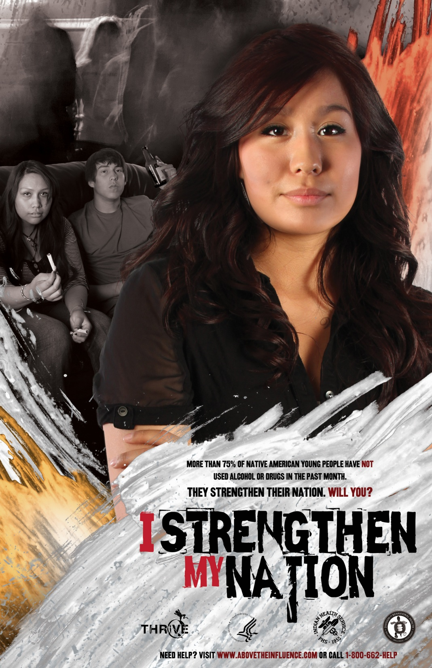
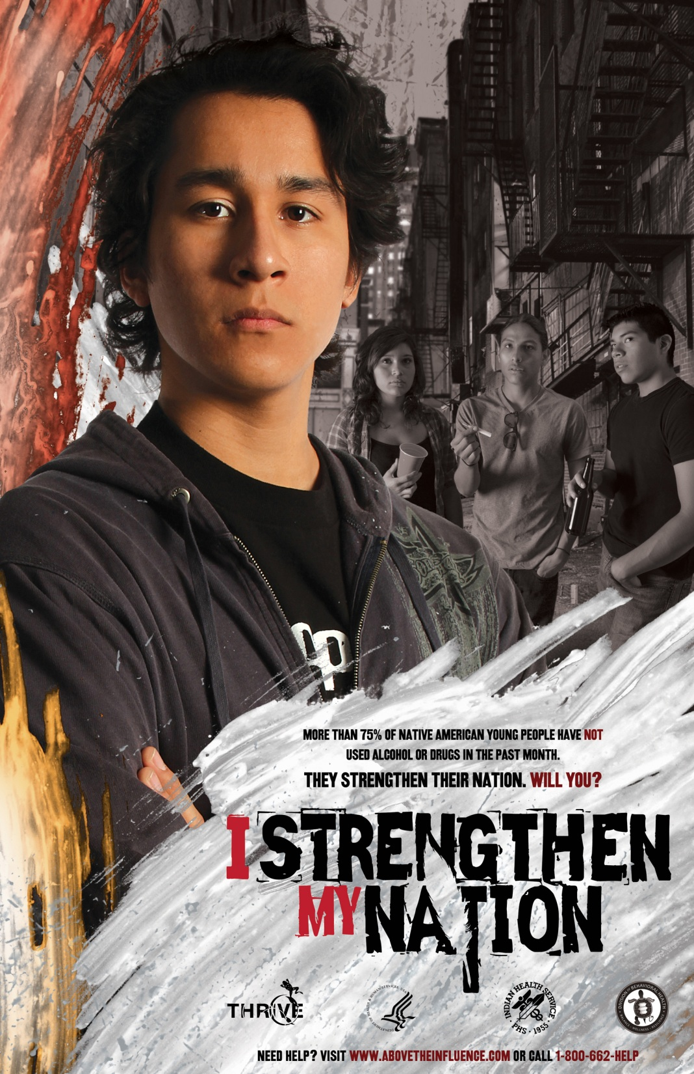

Slide 20
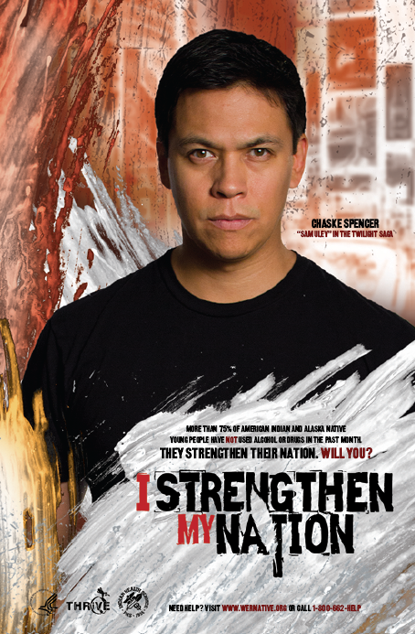
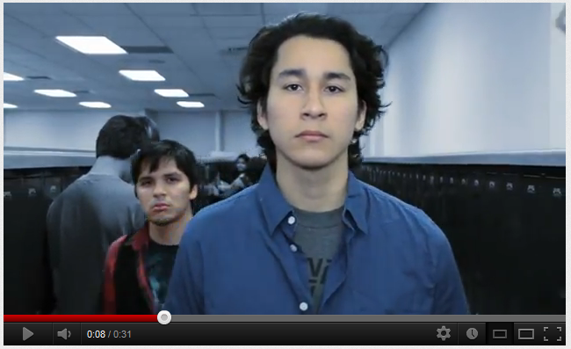
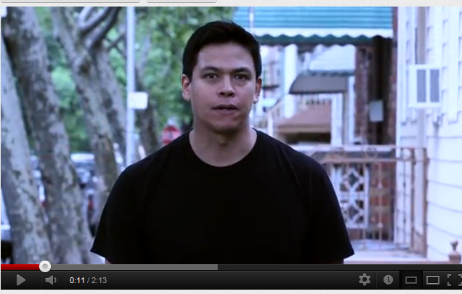
I Strengthen My Nation – PSA: http://www.youtube.com/watch?v=RZchHU5kpDs&feature=plcp
I Strengthen My Nation Extended: http://www.youtube.com/watch?v=oLoovbxaoFE&feature=plcp
Notes:
Image: Poster with celebrity endorsement

Slide 21
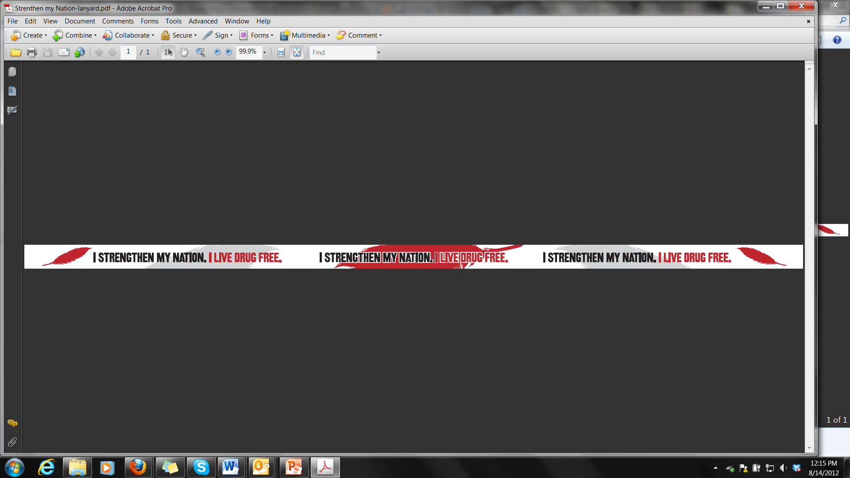
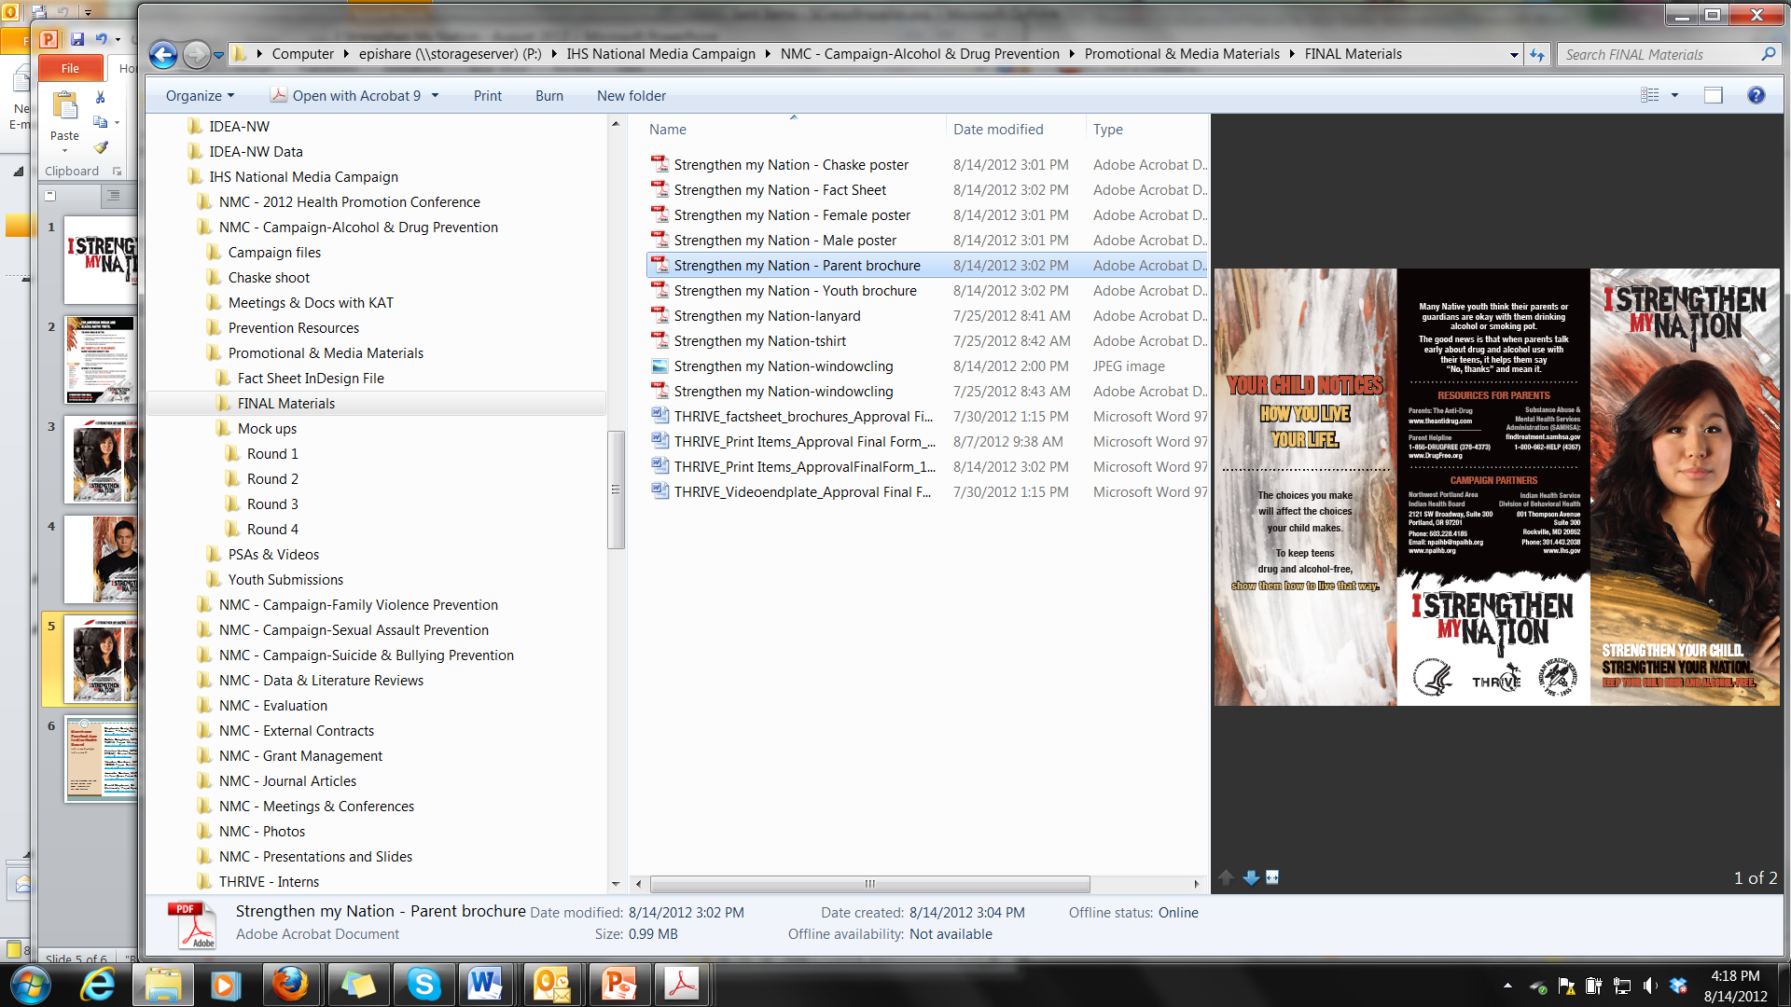
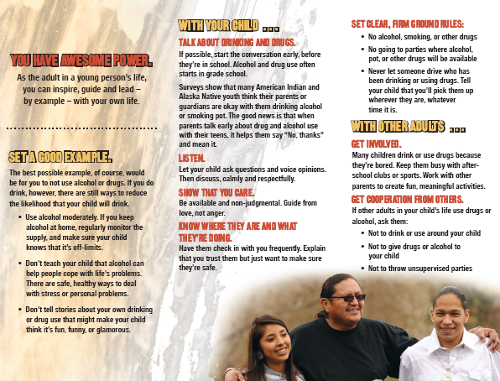
Notes:
Image: Parent brochure – front, middle, back

Slide 22
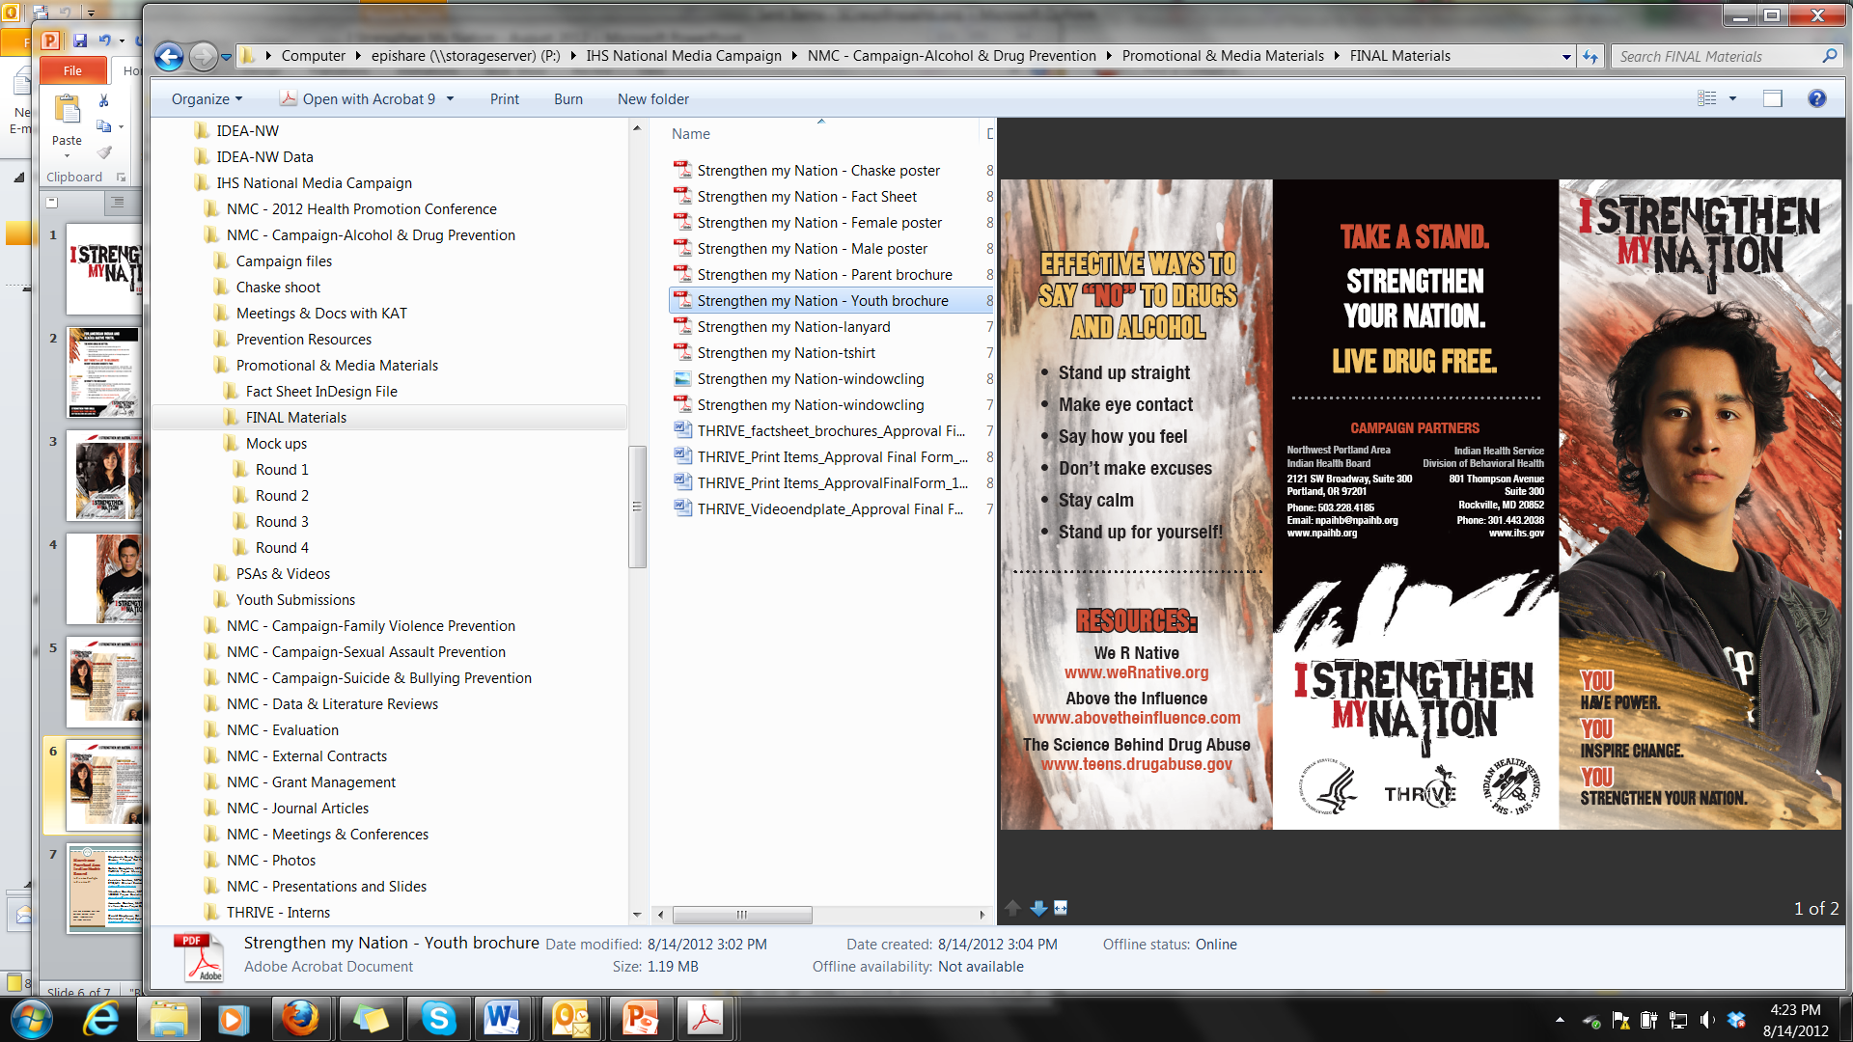
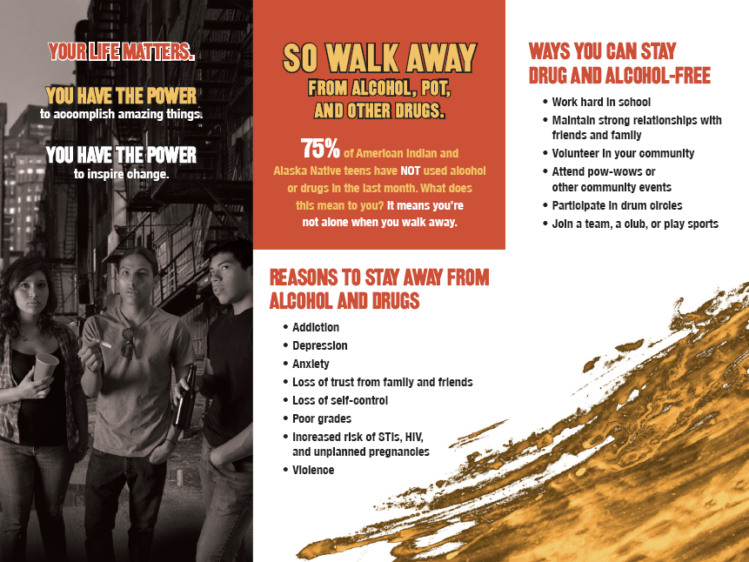
Notes:
Image: Youth brochure – front, middle, back

Slide 23
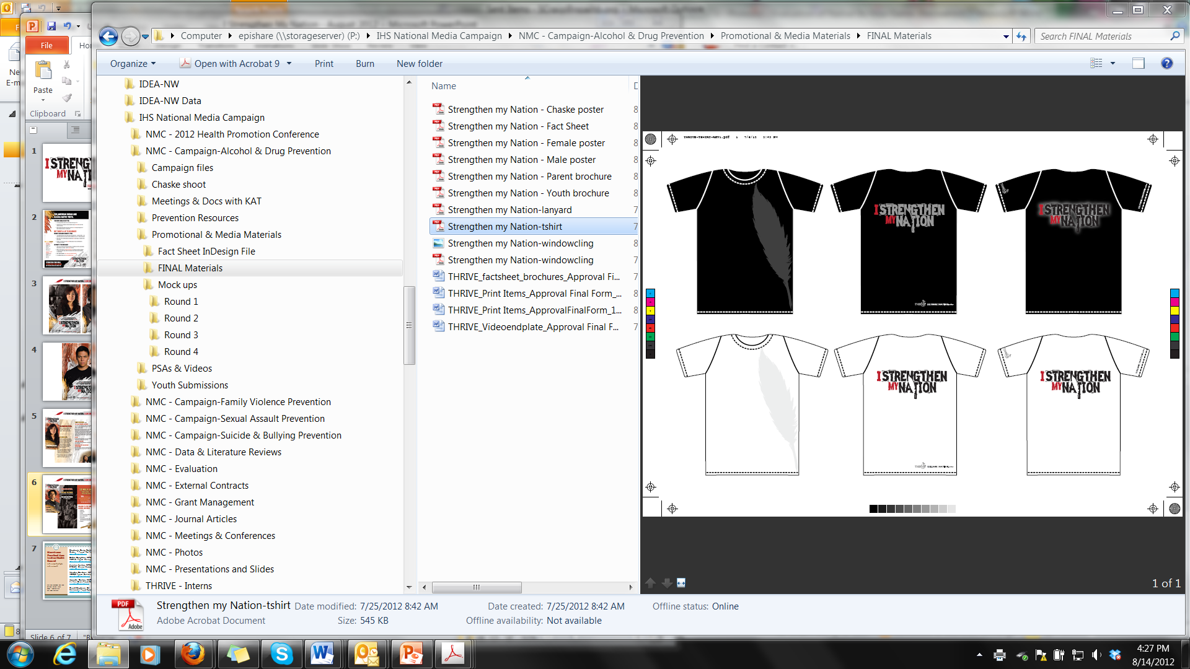
Notes:
Shirts: Front and back

Slide 24
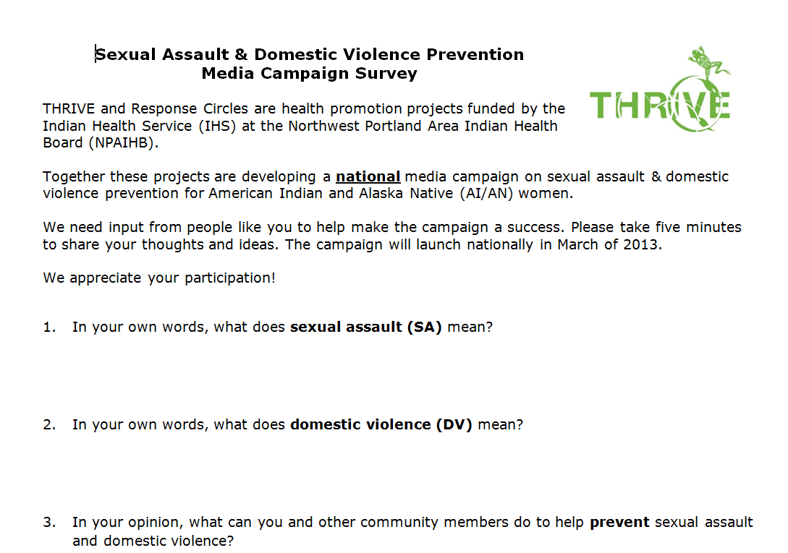
Next Media Campaign

Slide 25
Northwest Portland Area Indian Health Board
Stephanie Craig Rushing, PhD, MPH
Director – Project Red Talon & THRIVE
scraig@npaihb.org
Colbie Caughlan, MPH
THRIVE Project Manager
ccaughlan@npaihb.org
Jessica Leston, MPH
STD/HIV Clinical Services Manager
jleston@npaihb.org
Wendee Gardner, MPH
VOICES Project Coordinator
wgardner@npaihb.org
Amanda Gaston, MAT
It’s Your Game Project Coordinator
agaston@npaihb.org
David Stephens, BA
Multimedia Project Specialist
dstephens@npaihb.org
Indian Leadership for Indian Health

